Slide 1
MDPI
Deep Learning-Based Method to Recognize Line Objects and Flow arrows from Image-Format Piping and Instrumentation Diagrams for Digitization
Yoochan Moon, Jiwon Lee, Duhwan Mun and Seungeun Lim
CHANGWON NATIONAL UNIVERSITY

Slide 2
Introduction
Image recognition has been studied for a long time in computer vision
OpenCV
Recent development of AI, deep learning-based image recognition is being applied in the engineering field
Drawing digitization, manufacturability verification, fault diagnosis

Slide 3
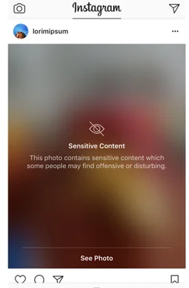
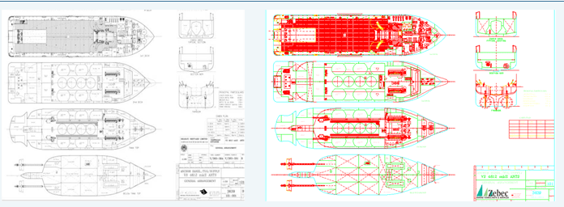
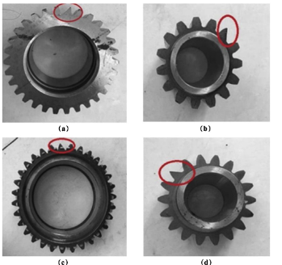
Introduction
Drawing paper → AutoCAD, pdf format digitization
Instagram sensitive contents filter
Zebec marine service, http://www.zebecmarine.com/ship-plans-digitization.asp
https://www.techspot.com/news/68636-instagram-adding-sensitive-content-filter-enables-two-factor.html
Fault diagnosis of rotating machinery
C. Wu, P. Jiang, C. Ding, F. Feng, T. Chen, Intelligent fault diagnosis
of rotating machinery based on one-dimensional convolutional
neural network, Computers in Industry,2019

Slide 4
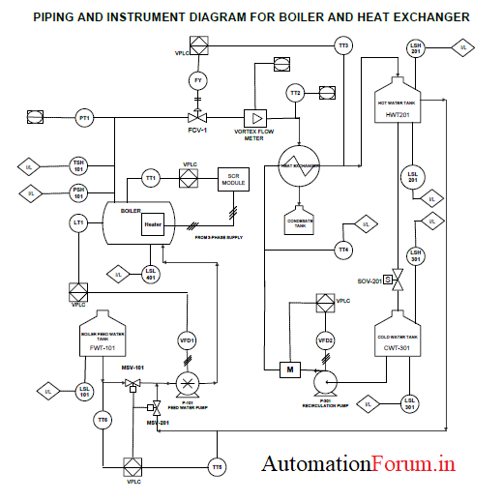
Introduction
Piping and instrumentation diagram(P&ID, 공정배관 계장도)
P&ID developed based in process flow diagram(공정흐름도)
공정을 구성하는 배관흐름과 설비관계를 상세하게 기술한 도면
P&ID includes piping, equipment, fitting and relationship of these components and flow
P&ID used as master data of detailed design, construction and operation
Therefore, when the need arises, P&ID must be quickly and accurately searched
Boiler P&ID, https://forumautomation.com/t/p-id-diagram-for-boiler/5838

Slide 5
Introduction
Presently, most engineering, procurement and construction(EPC) companies use digital P&ID
But, P&ID provided by the manufacturers are in an image format in many cases
Due to contractual relationships or issue of intellectual property and security
And in case of aging plant that have been operation for a long time
A large amount of P&IDs are stored in image format
Making digitization for these image-format P&IDs necessary

Slide 6
Introduction
P&ID digitization
High-level objects in the image format diagram are identified
Relationship between these objects is formed
Input engineering attributes required for objects
Create a digital diagram
The process of digitization of P&ID can be categorized
Recognizing diagram object in the image
Identifying the relationship between object
Creating a digital P&ID from obtained information

Slide 7
Introduction
At present, these processes are performed manually
This paper proposes a method for recognizing various types of line objects and flow arrows included in P&ID
Line: continuous line, lines incorporation line signs, Etc.
Flow arrow: direction symbol of pipeline direction
Proposed method consist of three steps
Remove the outer border and title box in the diagram
Continuous lines detect and then line signs and flow arrows detection
Using the results form the detection, determine line type and merge the arrow

Slide 8
Contribution
Various types of lines were recognized by of image processing and deep learning
Flow arrows were recognized and merged as the sub-element of the recognized line.
Define format of the training data required for deep learning-based recognition
Dataset was constructed.

Slide 9
Related work
Object detection
Perform object classification and localization from input image
Feature extraction for object classification from conventional image processing technique
Histogram of oriented gradient(HOG)
Scale invariant feature transform(SIFT)
Local binary pattern(LBP)
Modified census transform(MCT)
Object classifier using extracted feature data(select specific object region)
Support vector machine(SVM)
Adaboost

Slide 10
Related work
Object detection
Perform object classification and localization from input image
Feature extraction for object classification from conventional image processing technique
Histogram of oriented gradient(HOG)
Scale invariant feature transform(SIFT)
Local binary pattern(LBP)
Modified census transform(MCT)
Object classifier using extracted feature data(select specific object region)
Support vector machine(SVM)
Adaboost

Slide 11
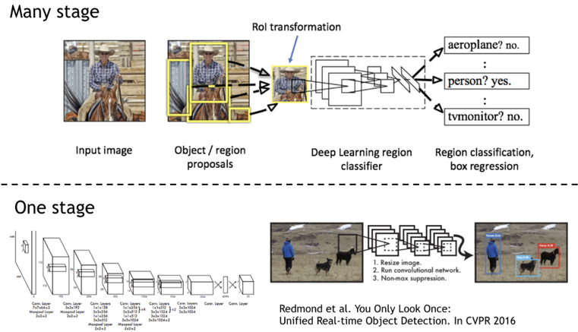
Related work
Deep learning-based object detection technique
One-stage detector: regional proposal and classification are performed in simultaneously
Two-stage detector: regional proposal and classification are performed in sequentially
One-stage detector: YOLO, SSD, RetinaNet
↓ inference time
Two-stage detector: R-CNN, Fast R-CNN, Faster R-CNN
↑ accuracy
https://medium.com/@jitender_phogat/1-2-introducing-retinanet-and-focal-loss-for-dense-object-detection-7ef9c4901b61

Slide 12
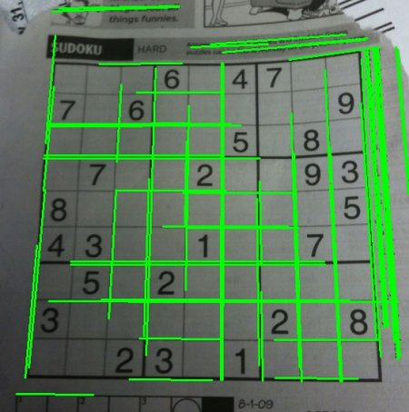
Related work
Hough transform
Commonly used for recognizing lines in an image
평면에서 한점을 지나는 직선과 만나는 점이 임계 값 이상으로 많을 때 선으로 판단
Hough transform has recognition problem about line thickness
thinning(세션화)
두께를 가진 이미지를 형태특성만 남도록 처리
픽셀을 순회하며 픽셀간 연결성을 판단, 연결성이 없는 픽셀은 제거
굵은 선을 1픽셀 선으로 변환하여 hough transform 수행
https://docs.opencv.org/4.x/d6/d10/tutorial_py_houghlines.html

Slide 13
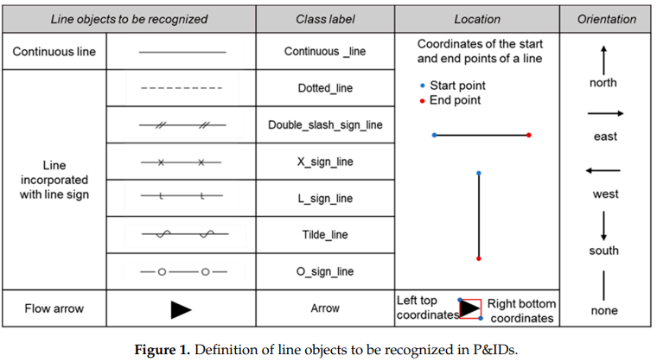
Method of recognizing line objects
Class definition of line objects to be recognized in P&ID
Class label: type of line
Location: coordinate

Slide 14
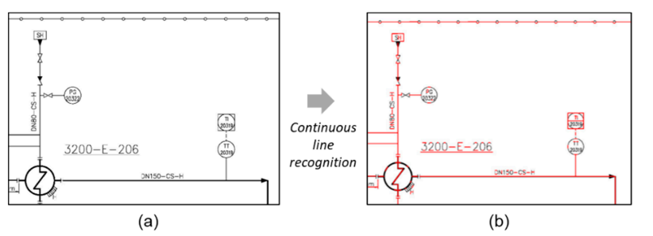
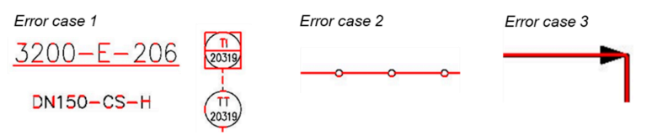
Method of recognizing line objects
Problems when recognizing line objects using image processing-based method
Text and symbols are recognized as a line(Error case 1)
line type was not recognized to fit the line sign embedded in the continuous line(Error case 2)
information of the flow arrow detection is not merged with the line object(not supported)(Error case 3)
It is not efficient for detecting line sign and flow arrows

Slide 15
Method of recognizing line objects
Deep learning shows high performance in detecting objects of a set of anchor sizes and ratios
It is suitable for detecting line sign and flow arrows
But difficult to detect a continuous line in which a line sign is embedded
Solution
Image processing-based method + Deep learning
Line detection: image processing-based method
Sign detection: Deep learning-based method

Slide 16
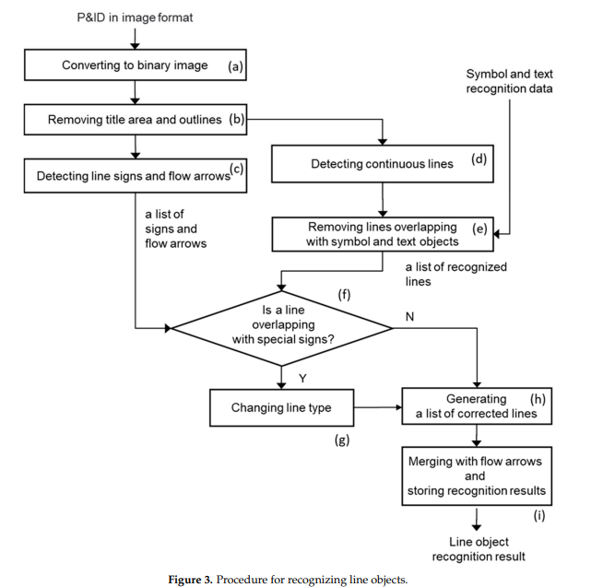
Method of recognizing line objects
Proposed scheme
Consist of two branch and process at the same time
Line detection: remove overlapped line with symbol, pure line only
Object detection: detect symbol only
Merge the result of branch
Regenerate overlapped line
Merge the line and symbol(sign, arrow)
Image processing method
Deep learning method

Slide 17
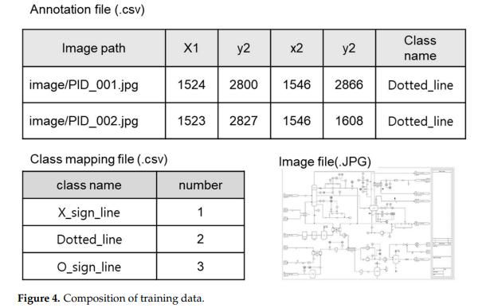
Training Dataset construction for line recognition
Training dataset for train of deep learning model that detect sign and arrows in P&ID
Composition
P&ID image file(.jpg)
Annotation file(.csv) include object bounding box coordinate, object class
Class mapping file(.csv) class name : number map

Slide 18
Training Dataset construction for line recognition
Training flow
DL
model
class prediction
Loss func()
Weight
optimizer
position prediction
(bounding box)
Update weight

Slide 19
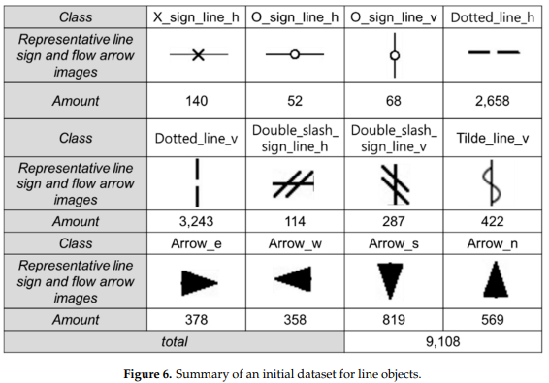
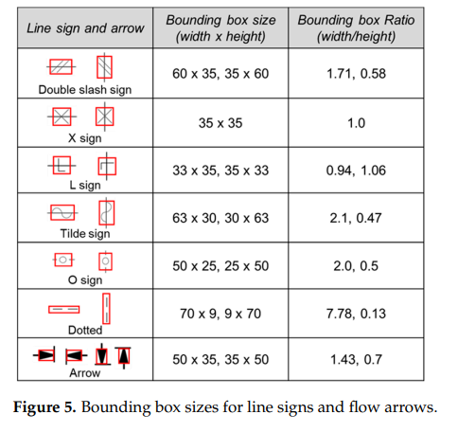
Training Dataset construction for line recognition
Object bounding box creation
When creating annotation files signs and arrows, bounding boxes corresponding to the area of the object are created
Set the bounding box size of each sign and arrow
Divide as horizontal and vertical in same object
Initial dataset consisting of 9108 data was constructed(82 sheets of remodeled P&ID)

Slide 20
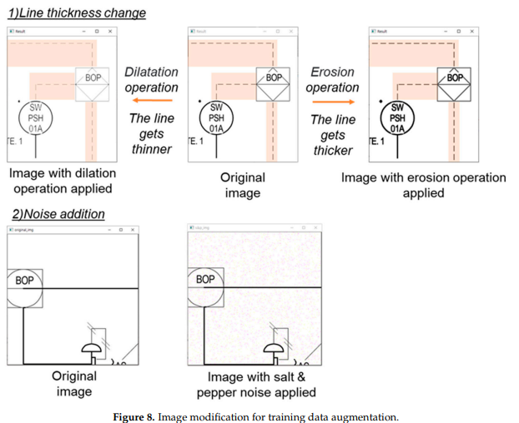
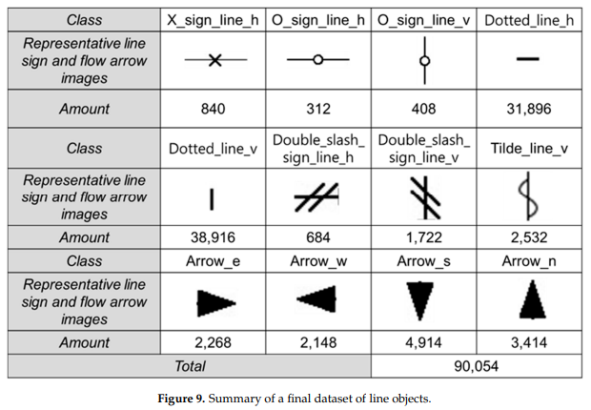
Data augmentation
Performing training with a small number of image data may lead to a problem of overfitting
The amount of training data was increased using the image augmentation technique
Amount of data: 9108 → 90,054

Slide 21
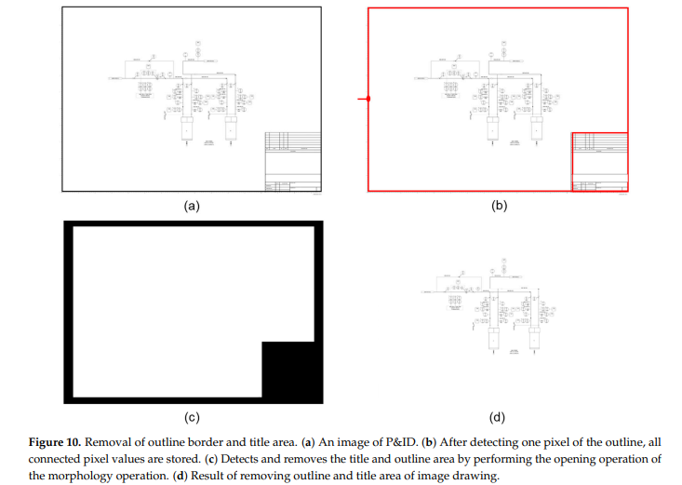
Remove outer border
Convert original image into binary image
Search from the left-center to right of the diagram
픽셀값이 임계값보다 크고 연속적인 픽셀들을 탐지
Perform morphology operation for detect outline
Erosion → dilatation
Remove area using image drawing

Slide 22

Continuous line detection
The continuous lines in a diagram have various thicknesses.
Use Hough transform

Slide 23
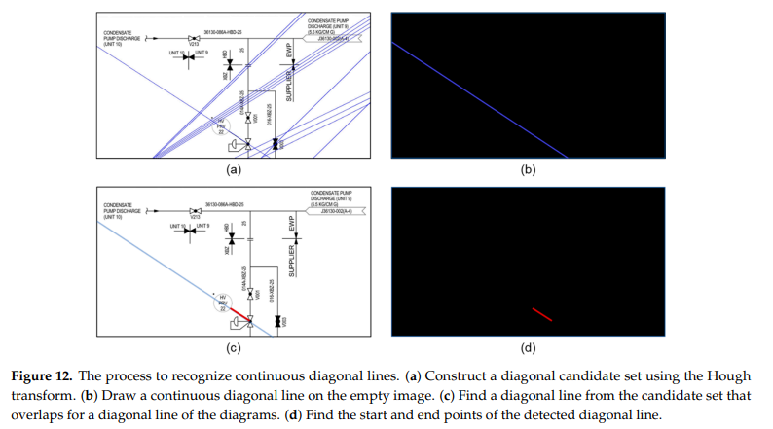
Continuous line detection
Diagonal line detection
All continuous lines in the diagram are searched using the Hough transform
Then, horizontal and vertical lines are removed from the searched lines
Construct a candidate set of diagonal lines
AND bitwise operation is performed with line drawn image and original image

Slide 24
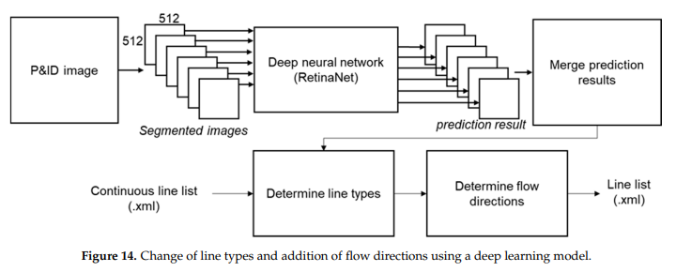
Sign and arrow detection
After line detection complete, line sign and flow arrows are identified
Input: P&ID image(9933x7016 resolution)
This is segmented into several small images
From the segmented images, line sign and flow arrows are detected using Deep learning model
After completing the prediction, the sign and arrow detection results are merged into one image
The type of the continuous line is changed to match the line sign
Line detection result

Slide 25
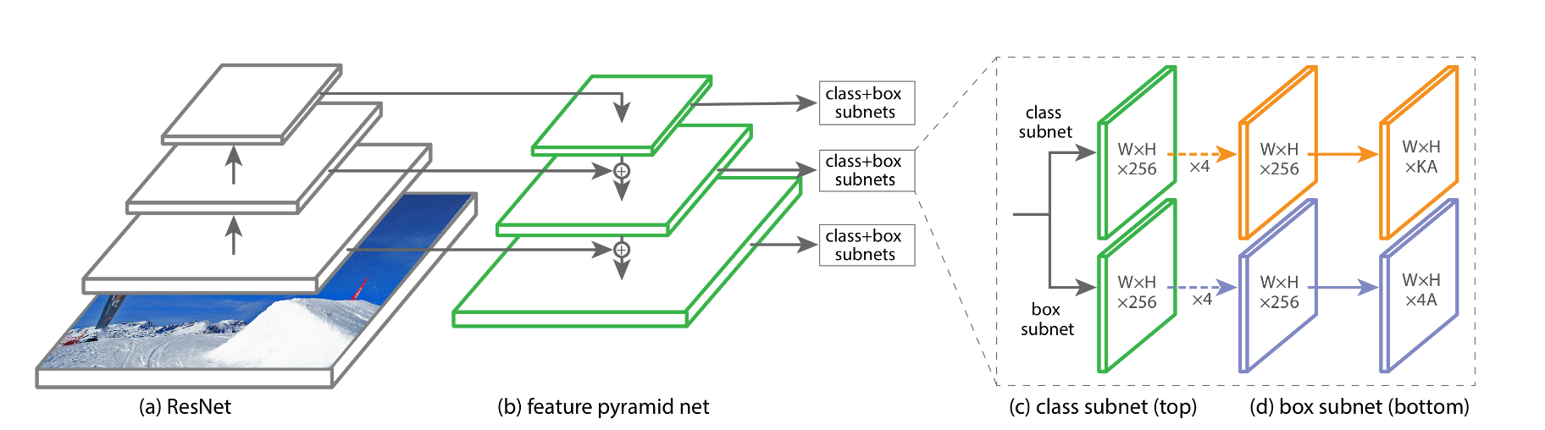
Sign and arrow detection
The sign, arrow detection model use RetinaNet
RetinaNet has the feature pyramid net architecture
RetinaNet uses a focal loss for prevent class imbalance
예측 난이도가 쉬운 객체에 의해 난이도가 어려운 객체 탐지 정확도가 더 낮아지는 경향이 있음
클래스 예측 난이도별 가중치를 변경
Anchor (bounding box)
prediction
5 different scale
Feature output
Backbone network
T. Lin. et al., Focal Loss for Dense Object Detection, arXiv, 2018

Slide 26
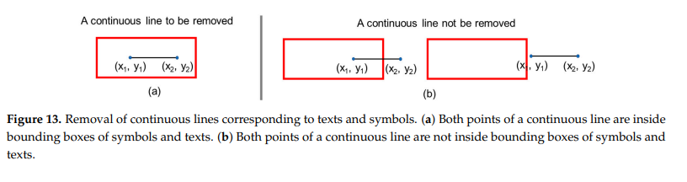


Changing of line type and merging of lines
To change the line type, make sure that the sign overlaps with the continuous line.
Procedure to assess the overlapping of the sign with the lines
: Anchor(bounding box)
❶: Remove overlapped line with anchor
: Detected line after remove overlapped area with anchor
❷: Calculate distance from the center of the anchor for a line
❸: If the distance is shorter than the width and height of anchor, determine line type
❹: After determine line type, merge to one line

Slide 27
Evaluation
H/W setup
CPU: AMD Ryzen 7 2700x
Memory: 64GB
GPU: Nvidia GeFroce RTX 2080Ti X 2
S/W setup
Window10
Python3.7
TensorFlow 2.3.0
Keras2.4
Dataset
82 P&IDs remodeled based on the provided by the ‘K’(?) company(9933x7016 resolution)
Train:validation = 9:1

Slide 28
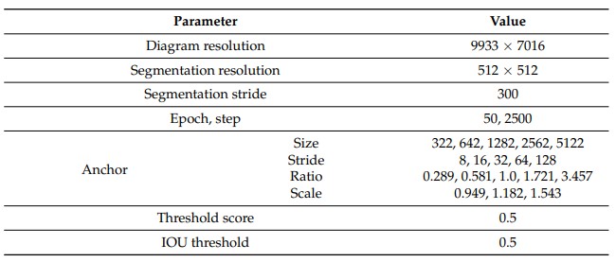
Evaluation
Model parameter
Epoch: 50

Slide 29
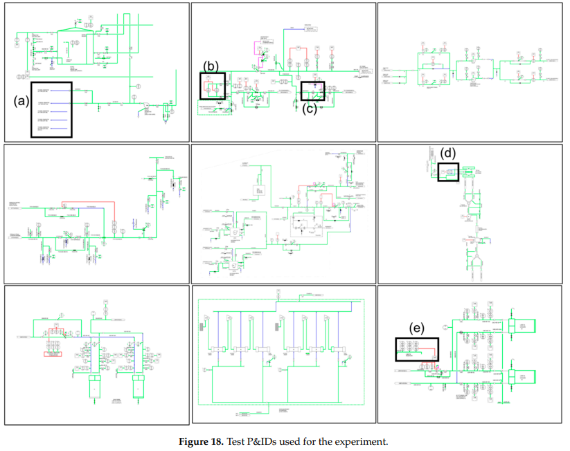
Evaluation
Tested P&ID used for the evaluation

Slide 30
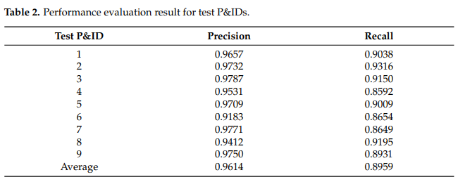
Evaluation
Result

Slide 31
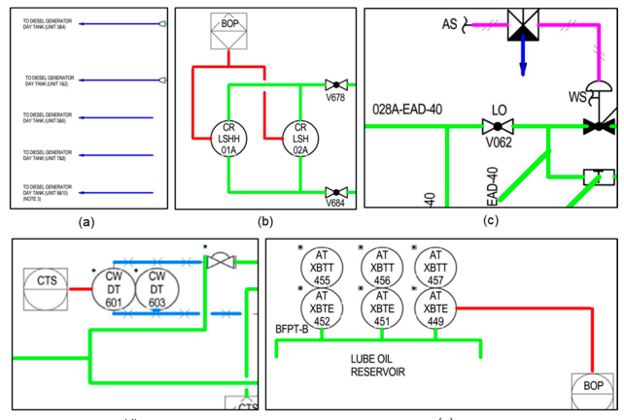
Evaluation
Line recognition result

Slide 32
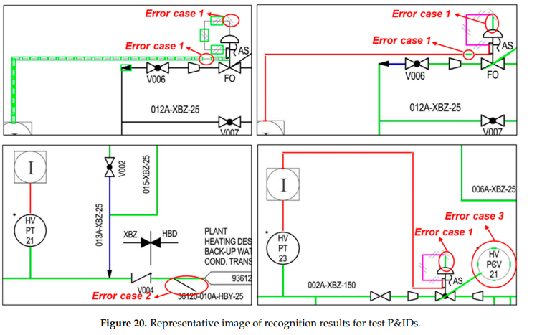
Evaluation
Error case
After sign detection and regenerate line, error case occurred
Error case 1 can be solved by increasing the training data
Other error case can be prevented by improving the recognition accuracy of sign

Slide 33
Conclusion
A novel method for recognizing various types of lines in image-format P&ID was proposed
Proposed method consist of three step
Remove outer border
Detect line, sign, arrow
Determine line type, merge
As for the recognition result for nine test P&IDs, average precision and recall were 96.14% and 89.59%
Following additional research will be conducted to shorten the recognition time

